Slide 1
Ethical Hacking
Mohona Ghosh

Slide 2
Malicious Software
Malicious software is software that is intentionally included or inserted in a system for a harmful purpose.

Slide 3
Malicious Software
Malicious software can be divided into two categories
those that need a host program
those that are independent
The former are essentially fragments of programs that cannot exist independently of some actual application program, utility, or system program
E.g., Viruses, logic bombs, and backdoors
The latter are self-contained programs that can be scheduled and run by the operating system
E.g., Worms and zombie programs

Slide 4
Malicious Software
Another differentiation category
Software threats that do not replicate
Software threats that can replicate
The former are programs or fragments of programs that are activated by a trigger
E.g., Logic bombs, backdoors, and zombie programs
The latter consist of either a program fragment or an independent program that, when executed, may produce one or more copies of itself to be activated later on the same system or some other system.
E.g., Viruses and worms

Slide 5

Virus
A virus is a piece of software that can "infect" other programs by modifying them
The modification also includes a copy of the virus program, which can then go on to infect other programs
A computer virus carries in its instructional code the recipe for making perfect copies of itself
The typical virus becomes embedded in a program on a computer. Then, whenever the infected computer comes into contact with an uninfected piece of software, a fresh copy of the virus passes into the new program
Thus, the infection can be spread from computer to computer by unsuspecting users who either swap disks or send programs to one another over a network. In a network environment, the ability to access applications and system services on other computers provides a perfect culture for the spread of a virus

Slide 6
Virus

Slide 7

Virus
A virus can do anything that other programs do. The only difference is that it attaches itself to another program and executes secretly when the host program is run. Once a virus is executing, it can perform any function, such as erasing files and programs
A virus can be prepended or postpended to an executable program, or it can be embedded in some other fashion. The key to its operation is that the infected program, when invoked, will first execute the virus code and then execute the original code of the program

Slide 8

Virus Structure
An infected program begins with the virus code and works as follows
The first line of code is a jump to the main virus program
The second line is a special marker that is used by the virus to determine whether or not a potential victim program has already been infected with this virus
When the program is invoked, control is immediately transferred to the main virus program
The virus program first seeks out uninfected executable files and infects them.

Slide 9
Virus Structure
Next, the virus may perform some action, usually detrimental to the system. This action could be performed every time the program is invoked, or it could be a logic bomb that triggers only under certain
conditions
Finally, the virus transfers control to the original program. If the infection phase of the program is reasonably rapid, a user is unlikely to notice any difference between the execution of an infected and uninfected program.

Slide 11

Lifecycle of a virus
During its lifetime, a typical virus goes through the following four phases:
Dormant phase: The virus is idle. The virus will eventually be activated by some event, such as a date, the presence of another program or file, or the capacity of the disk exceeding some limit. Not all viruses have this stage.
Propagation phase: The virus places an identical copy of itself into other programs or into certain system areas on the disk. Each infected program will now contain a clone of the virus, which will itself enter a propagation phase.
Triggering phase: The virus is activated to perform the function for which it was intended. As with the dormant phase, the triggering phase can be caused by a variety of system events, including a count of the number of times that this copy of the virus has made copies of itself.
Execution phase: The function is performed. The function may be harmless, such as a message on the screen, or damaging, such as the destruction of programs and data files.

Slide 12
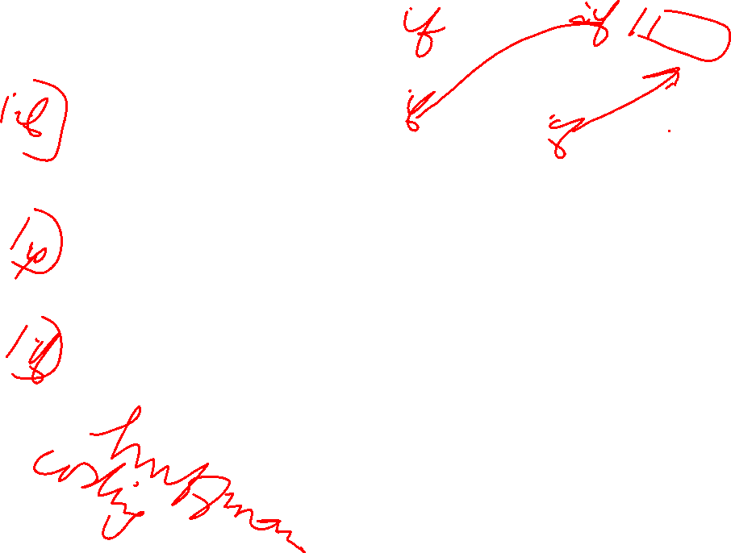
Virus Structure
A virus such as the one just described is easily detected because an infected version of a program is longer than the corresponding uninfected one.
A way to thwart such a simple means of
detecting a virus is to compress the
executable file so that both the infected
and uninfected versions are of identical length.

Slide 13
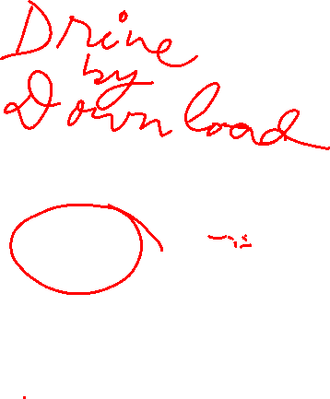
Initial Entry
In order to infect a computer, the attacker must first get the installation program to the victim.
Attackers do this through e-mail, peer-to-peer networks, USB or even on a regular Web site.
Most of the time, attackers disguise the malicious program with a name and file extension so that the victim thinks she's getting something entirely different.
Many a times, pop-up ads are used to install viruses into the system. E.g., a "No Thanks" button on the pop-up ad which is a decoy. Instead of dismissing the annoying pop-up ad, they activate a download of malicious software
Attackers incorporate viruses in popular software programs and upload the infected software on websites in tended to download software. When the victim downloads the infected software and installs it, the system gets infected.

Slide 16


Slide 18

Types of Viruses
Parasitic virus: The traditional and still most common form of virus. A parasitic virus attaches itself to executable files and replicates, when the infected program is executed, by finding other executable files to infect
Memory-resident virus: Lodges in main memory as part of a resident system program. From that point on, the virus infects every program that executes
Boot sector virus: Infects a master boot record or boot record (Areas on the disk that are executed when the PC is booted) and spreads when a system is booted from the disk containing the virus.

Slide 19

Boot Sector Virus

Slide 20

Types of Viruses
Stealth virus: A form of virus explicitly designed to hide itself from detection by antivirus software
Example: Polymorphic virus - A virus that mutates with every infection, making detection by the "signature" of the virus impossible.
Polymorphic virus creates copies during replication that are functionally equivalent but have distinctly different bit patterns. To achieve this variation, the virus may randomly insert superfluous instructions or interchange the order of independent instructions.
A more effective approach is to use encryption. A portion of the virus, generally called a mutation engine, creates a random encryption key to encrypt the remainder of the virus. The key is stored with the virus, and the mutation engine itself is altered. When an infected program is invoked, the virus uses the stored random key to decrypt the virus. When the virus replicates, a different random key is selected.

Slide 21
Encryption Viruses

Slide 22
Polymorhic Virus

Slide 24
A virus attack example

Slide 25
Domain Name Server
A DNS server is a computer server that contains a database of public IP addresses and their associated hostnames, and in most cases serves to resolve, or translate, those names to IP addresses as requested.
It's easier to remember a domain or hostname like lifewire.com than it is to remember the site's IP address numbers 151.101.2.114. So when you access a website, like Lifewire, all you have to type is the URL https://www.lifewire.com.
However, computers and network devices don't work well with domain names when trying to locate each other on the internet. It's far more efficient and precise to use an IP address, which is the numerical representation of what server in the network (internet) the website resides on.

Slide 26
Domain Name Server
When you type a website address into your browsers address bar and press Enter, a DNS server is responsible for finding the correct IP address for those sites.
Once the IP address is returned, the website you wanted to visit is then displayed in your web browser. It sounds like a lot of back and forth, and it is, but it all happens very quickly with little delay in returning the site you want to visit.
In most cases, a primary and a secondary DNS server are configured on your router or computer when you connect to your internet service provider. There are two DNS servers in case one of them happens to fail, in which case the second is used to resolve hostnames you enter.

Slide 27
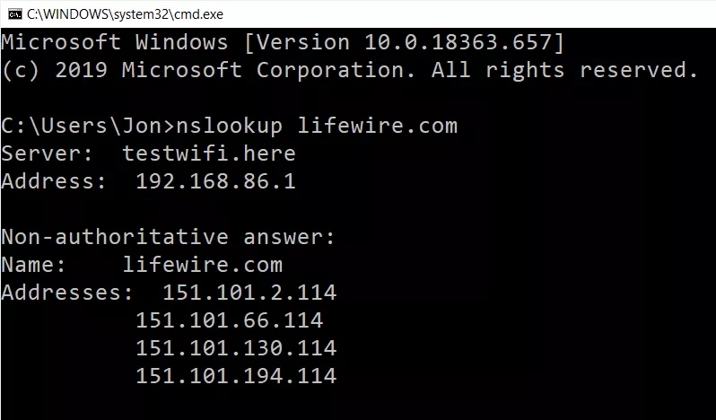
How to obtain DNS information
The nslookup command is used to query your DNS server on Windows PCs.
In the example above,
the nslookup command
tells you the IP address,
or several IP addresses
in this case, that the
lifewire.com address
translates to.

Slide 28

How virus/malware can attack ?
Suppose, your computer uses Google's DNS servers (8.8.8.8 and 8.8.4.4) and you open your bank's website, you naturally expect that when you enter its familiar URL, you'll be sent to the bank's website.
However, if malware changes your DNS server settings, which can happen without your knowledge after an attack on your system, your system no longer contacts Google's DNS servers but instead a hacker's server that poses as your bank's website.

Slide 29
How virus/malware can attack ?
This fake bank site might look exactly like the real one, but rather than logging you into your bank account, it harvests the username and password you just typed, giving the hackers the essential information they need to get into your bank account.
Malware attacks that hijack your DNS server settings may also redirect traffic away from popular websites to ones that are full of advertisements or to a fake site designed to scare you into believing your computer has been infected with a virus, and that you must buy their advertised software program to remove it.

Slide 30

A virus attack example - DNSChanger

Slide 31
Some tools to create Virus

